Slide 1


KRAKEN QGIS PLUGIN • USER MANUAL
KPI Trend
Historical Performance Analytics, Custom SQL Aggregations, Multi-Engine Database Querying & Custom Interactive Chart Styling
Dual Query Engines
Flexible Aggregations
Interactive Styling
Ultra-fast local processing via DuckDB or direct connection to remote PostgreSQL/PostGIS servers.
Hourly and daily trend grouping with dynamic multi-level breakdown dimensions.
Custom chart visuals, Y-axis limits, line styles, and SHA-256 state persistence.
Kraken © 2026 | akanipatra@gmail.com

Slide 2
MODULE OVERVIEW
Core Capabilities & Architecture
kpi_trend_dialog.py
Dual Engine Core
Multi-Level Breakdown
Cascading Filters
Native execution on DuckDB high-performance local files & PostgreSQL spatial server schemas.
Flexible X-axis temporal grouping across composite fields like Date, Time, Hour, or Custom Categories.
Real-time dynamic inter-dependent filter updates preventing invalid queries and zero-result views.
Kraken © 2026 | akanipatra@gmail.com

Slide 3
CONFIGURATION GUIDE
Data Input Specifications
QgsSettings Keys
1. Connection & Source Config
2. Dimension & Filter Setup
kpi_file_type: Engine choice ( / )
kpi_filter: Comma-separated dynamic filter columns
duckdb
postgresql
kpi_file_path: Local database file path (.duckdb / .db)
kpi_xaxis: X-axis datetime grouping fields (e.g. )
Date,Time
kpi_table_name: Target data table name or active view
kpi_xorder: Sorting sequence columns for timeline continuity
pg_host / pg_dbname: PostgreSQL host, port, user, schema credentials
kpi_object: Primary key/entity column (e.g. Cell_ID, Site_ID)
3. KPI Metrics Definition JSON ()
kpi_items_json
Defines metric assignment to visual cards with specific aggregation methods.
[{"kpi_name": "Payload_GB", "calc": "SUM", "card": 1}, {"kpi_name": "PRB_Util", "calc": "AVG", "card": 2}]
Kraken © 2026 | akanipatra@gmail.com

Slide 4
ADVANCED ANALYTICS
Virtual CTE & Custom Expressions
get_base_source_and_cols()
Dynamic On-the-Fly SQL Expression Calculation
The engine injects custom formula JSON () into a virtual CTE table subquery, exposing synthetic metrics directly to filtering, grouping, and charting routines without mutating physical database schemas.
-- DuckDB CTE Injection Generated Code
WITH src_data AS (
SELECT * EXCLUDE (Custom_Accessibility),
(RRC_Setup_Success_Rate * ERAB_Setup_Success_Rate / 100)
AS "Custom_Accessibility"
FROM "tbl_kpi_hourly"
)
SELECT "Date", AVG("Custom_Accessibility")
FROM src_data
GROUP BY "Date";
kpi_custom_columns_json
Security Guardrails Built-in
SQL Injection sanitizer blocks stacked queries (), comments (), and DDL/DML keywords (, , ).
;
--
DROP
DELETE
INSERT
Kraken © 2026 | akanipatra@gmail.com

Slide 5
INTERFACE GUIDE
Dialog Workspace & Layout Controls
QSplitter Layout
Left Control Panel (270px)
Right Chart Canvas Grid
Display Mode Switcher: Quick 1 to 4 Column Grid buttons ( to )
Active Filter Status Bar: Displays selected parameters with item counter badges
■
■■■■
Responsive Scroll Area: Scrollable dynamic grid housing Matplotlib KPI cards
Dynamic Filter Scroll Area: Searchable listboxes per configured dimension
Spatial GIS Lookup Override: Direct external filter injection via map selection
X-Axis Format Controls: Inline datetime string pattern formatters
Kraken © 2026 | akanipatra@gmail.com

Slide 6


VISUALIZATION MODES
Multi-Object vs Multi-KPI Trend Modes
kpi_chart_type
Multi Object Single KPI
Single Object Multi KPI
VS
Plots one KPI metric across multiple selected RAN entities (e.g., comparing 10 cells on one chart).
Plots multiple different KPI metrics simultaneously for a single selected network object.
GROUP BY X-Cols + Object_Col
GROUP BY X-Cols (Multi-Metric SELECT)
Kraken © 2026 | akanipatra@gmail.com

Slide 7

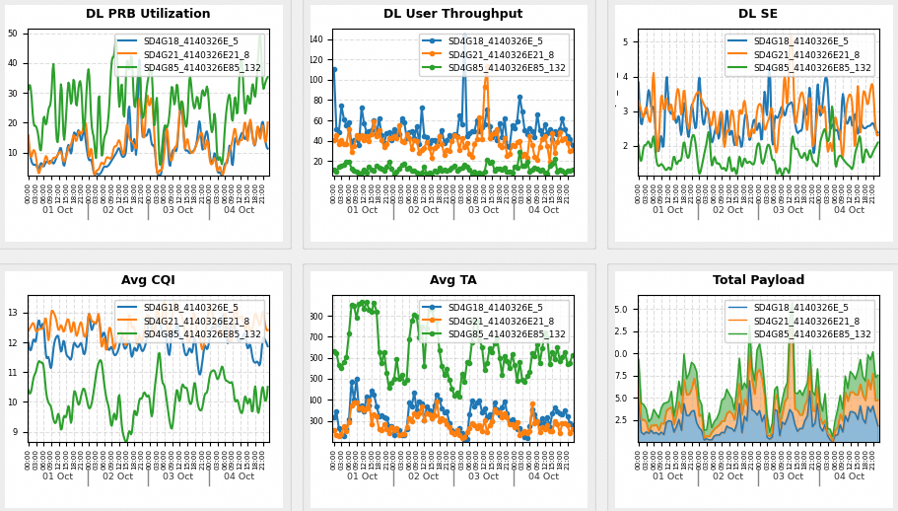
USER INTERFACE SPECIFICATION
Captured Chart Custom Setting Dialog
ChartSettingDialog
1. Chart Title & SQL Inspection
Editable chart title alongside read-only executable SQL preview for analytical query auditing.
2. KPI Granular Table Controls
Per-series scale bounds (Min/Max), Chart Type selector, Color Picker modal, and Axis Assignment (Primary/Secondary).
3. Display & Legend Customization
Legend position dropdowns, grid line options, and custom Primary/Secondary Y-axis text labels.
Kraken © 2026 | akanipatra@gmail.com

Slide 8
STYLING OPTIONS SPECIFICATIONS
Comprehensive Chart Styling Matrix
kpi_trend_dialog_chart.py
Category | Supported Configuration Options | Engine Behavior
Chart Types | Line with Markers, Simple Line, Smooth Line, Stepped Line, Simple Bar, Stacked Bar, Horizontal Bar, Simple Area, Stacked Area | Renders via Matplotlib artists with custom smooth spline interpolation (make_interp_spline).
Y-Axis Controls | Primary Y-Axis, Secondary Y-Axis, Custom Min/Max bounds, Dynamic Auto-scaling | Independent twin axes (ax.twinx()) with isolated numeric limits.
Grid Lines | Major Grid, Major & Minor, Horizontal Major, Vertical Major, None | Custom alpha styling (#e0e0e0) with automatic minor tick locators.
Legend Positions | Floating, Top, Right, Bottom, Left, Hidden | BBox anchor positioning with multi-column automatic legend layout.
Kraken © 2026 | akanipatra@gmail.com

Slide 9
INTERACTIVE FEATURES
Context Menu & SHA-256 Persistence
QgsSettings Hashing
Right-Click Context Menu
Hover Precision Tooltips
SHA-256 Config Persistence
Instant right-click menu on canvas providing quick shortcuts to change colors per series, swap chart types, re-position legends, or toggle grid styles on the fly.
Real-time Matplotlib motion notification listener tracking coordinates across Line markers, Bar patches, and Area polygons to display instant metric tooltips.
Chart configurations automatically saved into using SHA-256 hash keys generated from title + SQL query string.
QgsSettings
Kraken © 2026 | akanipatra@gmail.com

